Slide 1
Fatal Police Shooting (USA Records from 2015-2021)
Created: 9/1/2025 2:45:34 PM

Slide 2
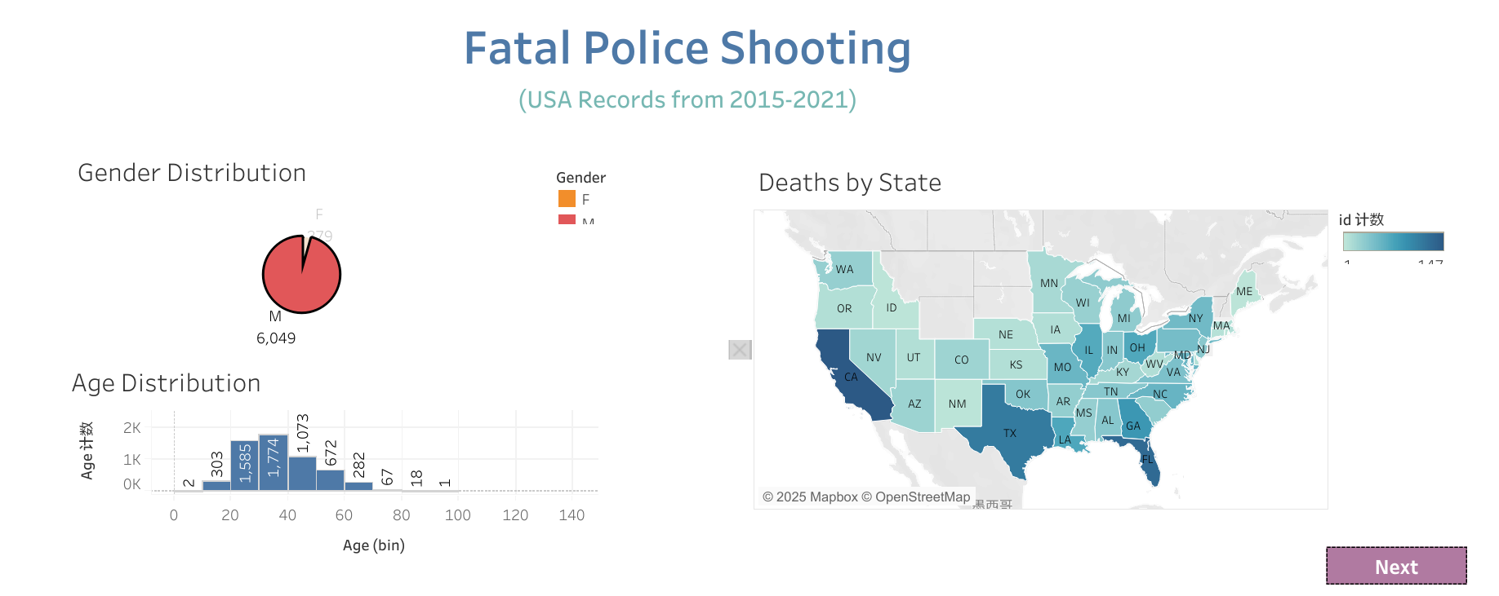

Slide 3
